Slide 1

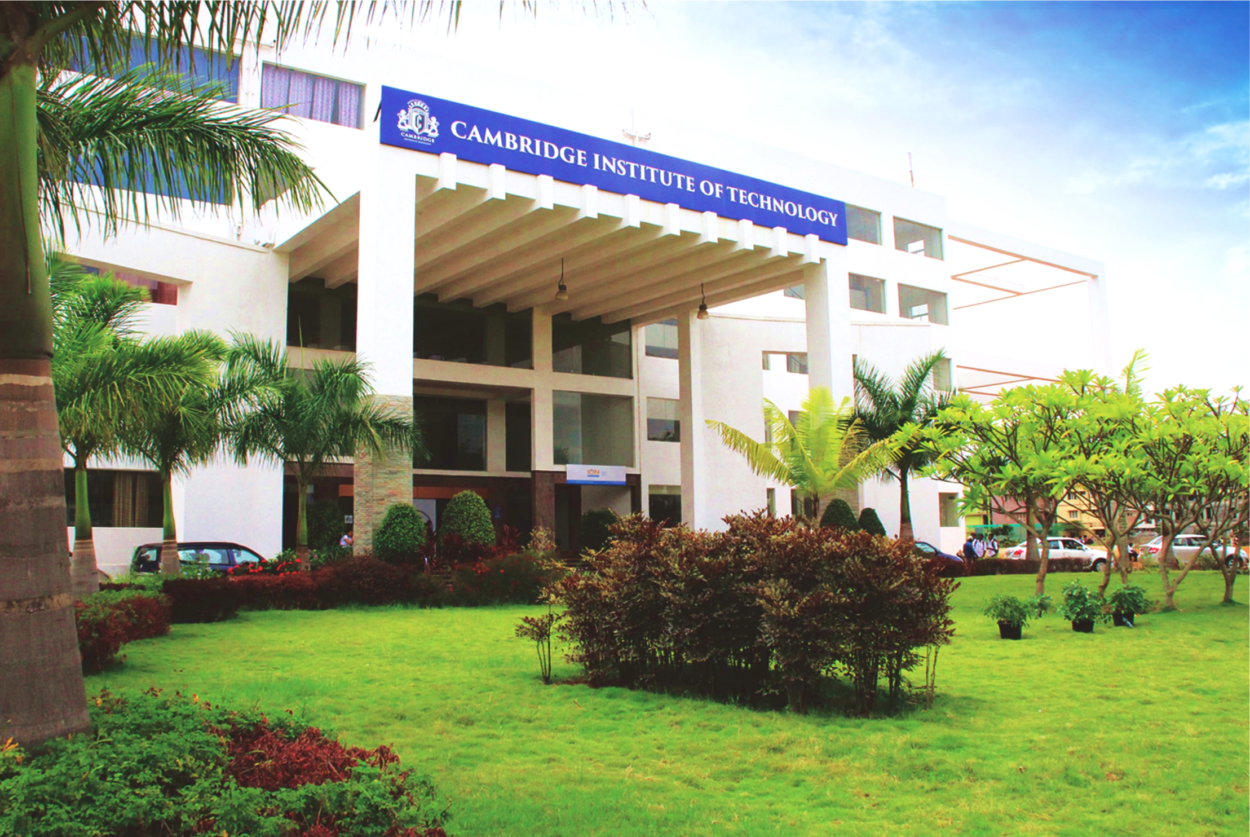
www.cambridge.edu.in
Subject Code:21AIMP67
Project Name:
AI enabled traffic congestion predictor and route optimizer
Presented By :
NAVEEN S 1CD20AI049
SHREYA M P 1CD20AI052
Department of Artificial Intelligence and Machine Learning

Slide 2
Abstract
RouteRover is an AI-driven solution designed to tackle traffic congestion in Indian cities. By analyzing historical data, real-time conditions, and contextual factors, RouteRover predicts traffic congestion and dynamically optimizes routes for urban commuters. This dual approach allows users to avoid traffic bottlenecks and reduce travel time. Tailored for the unique challenges of Indian urban environments, RouteRover enhances mobility, reduces commuting stress, and improves the quality of life for city residents. Through advanced AI and user-centric design, RouteRover offers a promising solution to urban traffic issues.
Department of Artificial Intelligence and Machine Learning www.Cambridge.edu.in

Slide 3
Introduction
Due to the increase in population and multiple number of private cars, traffic congestion has become remarkably worse. Including economic losses, damages to the environment. Multiple studies have been done to combat the surging rate of traffic congestion. To our knowledge, a city's traffic condition is affected by various factors, including city management, population density, and weather. Specifically, traffic flow is affected by rainfall. Few studies have shown that traffic efficiency and weather are firmly relevant. When the cars are forced to slow down or even stop on the road, they will be wasting time, they will consume more fuel, it will increase operating costs, and easily lead to traffic accidents. This series of perils means huge economic losses. Road congestion control is also an important aspect of the field of intelligent transportation. We are using numerous machine learning and deep learning models in this project. The datasets used is collected form Kaggle.
Department of Artificial Intelligence and Machine Learning www.Cambridge.edu.in

Slide 4
Literature Survey
SL NO | PAPER TITLE | JOURNAL NAME | DESCRIPTION | PROS | CONS
1 | A real-time traffic congestion detection system using on-line images | IEEEXPLORE.IEEE.ORG | The paper presents a cost-effective real-time traffic congestion detection system for Macao using online images from government cameras. It detects vehicles with Haar-like features applied to road signs in the images. Traffic congestion is estimated using thresholds for the image correlation coefficient between consecutive images and the number of detected vehicles, classifying congestion into NORMAL and CONGESTED levels. | Modular Structure Competent Longest Path Approximation Outperforms a1k0n Algorithm Real-Life Applicability | Limited Scalability Dependency on Realistic States Higher Computational Costs Need for Further Research
2 | Dynamic Traffic System Based on Real Time Detection of Traffic Congestion | IEEEXPLORE.IEEE.ORG | The paper proposes a dynamic traffic system that adapts to real-time traffic conditions by analyzing present traffic footage. It employs image processing techniques like background subtraction and edge detection to process video and calculate congestion percentages. Additionally, a clustering-based prediction mechanism is used to predict future congestion based on historical traffic patterns. The system is implemented on Raspberry Pi 0 W's and utilizes the OpenCV library for image processing. | Self learning models using reward system. Works on both labelled and unlabelled data. Real-Life Applicability | Describing the states. Dependency on Realistic States. Efficiency depends on strategies not pre-planned. Need for Further Research.
Department of Artificial Intelligence and Machine Learning www.Cambridge.edu.in

Slide 5
SL NO | PAPER TITLE | JOURNAL NAME | DESCRIPTION | PROS | CONS
3 | Simulation-Based Traffic Management Model to Minimize the Vehicle Congestion in Traffic Signals | IEEEXPLORE.IEEE.ORG | The paper addresses urban vehicular congestion, particularly at intersections, which is exacerbated by fixed-duration traffic light cycles used in conventional traffic control methods. These methods often lead to unnecessary congestion due to their computational complexity. The proposed model dynamically adjusts traffic light schedules in real-time at four-way intersections based on traffic density, considering both light and heavy traffic conditions. | Extension of Q-learning Associative Q-learning Dealing with Multiplicity of Nash Equilibriums | Limited Empirical Validation Complexity Assumptions
4 | Comprehensive traffic management system: Real-time traffic data analysis using RFID | IEEEXPLORE.IEEE.ORG | The paper identifies various traffic issues such as congestion, emergency vehicle passage difficulties, rule violations, vehicle breakdowns, and accidents. Previous smart traffic management systems focus mainly on vehicular density-based signal control and emergency vehicle passage but are limited in scope and not cost-effective. The proposed Comprehensive Traffic Management System (CTMS) utilizes RFID and analytics for real-time, cost-effective implementation. | Data Analysis helped to discover the relation between the algorithms and games to determine the best algorithm for a specified game on performance basis. | Need to promote more machine learning implementation on games with imperfect information. Need to promote a system that implements more than one Machine Learning algorithm based on a certain task.
Department of Artificial Intelligence and Machine Learning www.Cambridge.edu.in

Slide 6
Problem Statement
“India's rapid urbanization and population growth have caused severe traffic congestion, highlighting the inefficiency of traditional traffic management systems and resulting in increased stress, time loss, and pollution.”
Department of Artificial Intelligence and Machine Learning www.Cambridge.edu.in

Slide 7
Objectives
Enhanced Public Transportation Integration
Reduced Travel Time
Increased Public Awareness
Accurate traffic congestion prediction
Department of Artificial Intelligence and Machine Learning www.Cambridge.edu.in

Slide 8
Methodology or Architecture
Data Collection and Preparation
Data Analysis
Model development
Fine tuning
System Integration
Result
Department of Artificial Intelligence and Machine Learning www.Cambridge.edu.in

Slide 9
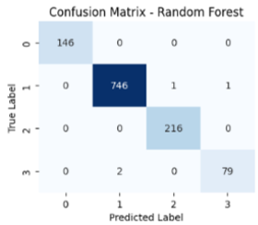
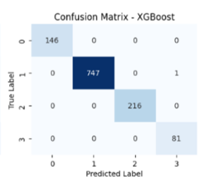
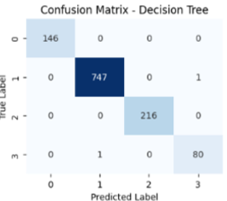
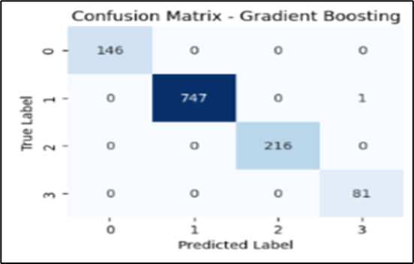
CONFUSION MATRIX FOR ML MODELS
Department of Artificial Intelligence and Machine Learning www.Cambridge.edu.in

Slide 10
Tools and Technologies
4. System Integration:
Flask/Django: Web Development
Docker: Containerization
Cloud Platforms: AWS, GCP, Azure
5. User Interface:
React/Angular: Web Interfaces
Bootstrap/Material-UI: UI Design
1. Data Collection:
APIs: Google Maps API, OpenStreetMap
Web Scraping: BeautifulSoup, Scrapy
2. Data Analysis:
Python: Pandas, NumPy
Databases: PostgreSQL, MongoDB
3. Machine Learning:
Scikit-Learn, TensorFlow/Keras , XGBoost
Department of Artificial Intelligence and Machine Learning www.Cambridge.edu.in

Slide 11
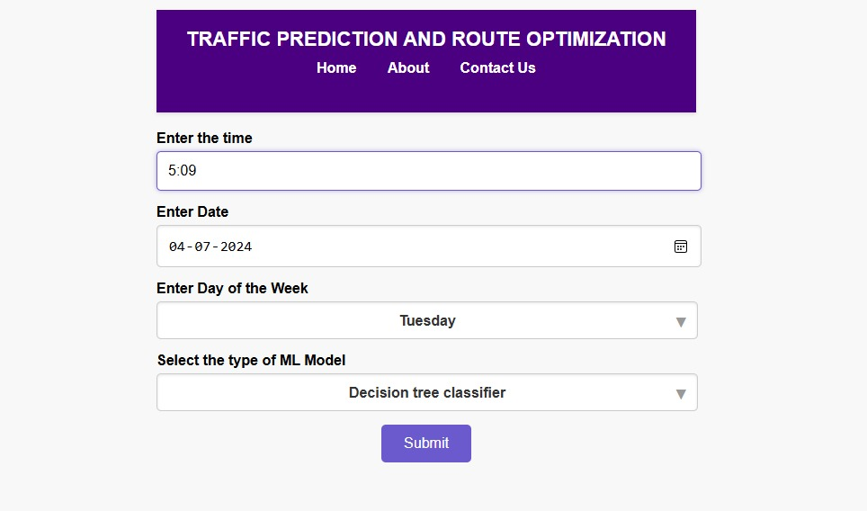
Output
Department of Artificial Intelligence and Machine Learning www.Cambridge.edu.in

Slide 12
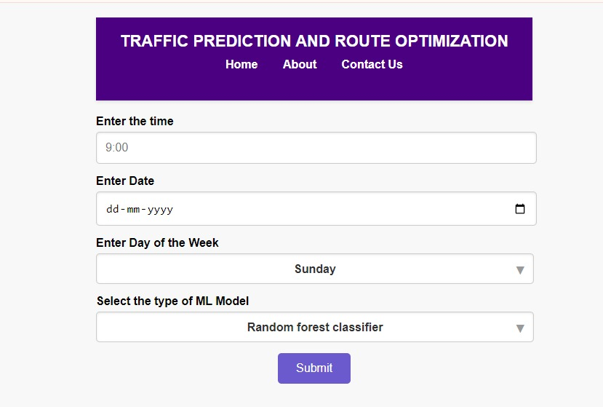
Results
Department of Artificial Intelligence and Machine Learning www.Cambridge.edu.in

Slide 13
Conclusion
Higher weekday traffic and peak volumes during morning and evening rush hours indicate commuter-related congestion. Predictive Accuracy of models accurately forecast total and vehicle-specific traffic counts, aiding traffic management and strategic planning. Real-time predictions facilitated timely decisions, with high correlations between vehicle types and total traffic highlighting their interdependence. Future efforts will enhance data integration and machine learning.
Department of Artificial Intelligence and Machine Learning www.Cambridge.edu.in

Slide 14
References
[1] [B. Priambodo, A. Ahmad and R. A. Kadir, "Predicting Traffic Flow Propagation Based on Congestion at Neighbouring Roads Using Hidden Markov Model," in IEEE Access, vol. 9, pp. 85933- 85946, 2021, doi: 10.1109/ACCESS.2021.3075911.
[2] Z. Lan, "Research on multi feature color extraction method of network illustration based on feature matching," 2021 6th International Conference on Smart Grid and Electrical Automation (ICSGEA), Kunming, China, 2021, pp. 417-421, doi: 10.1109/ICSGEA53208.2021.00101.
[3] W. Duan and Z. Gong, "Research and application of urban real-time traffic flow prediction based on STARIMA," 2022 IEEE International Conference on Advances in Electrical Engineering and Computer Applications (AEECA), Dalian, China, 2022, pp. 1521-1525, doi: 10.1109/AEECA55500.2022.9919038
[4] S. Hosseini and I. Hahn, "Kinodynamic Motion Planning and Energy Loss Cost Function Modelling for a 2- DOF Robot Arm Manipulator," 2020 IEEE International Conference on Industrial Technology (ICIT), Buenos Aires, Argentina, 2020, pp. 375-380, doi: 10.1109/ICIT45562.2020.9067281.
[5] A. Madraky, Z. A. Othman and A. R. Hamdan, "Hair data model: A new data model for Spatio-Temporal data mining," 2012 4th Conference on Data Mining and Optimization (DMO), Langkawi, Malaysia, 2012, pp. 18-22, doi: 10.1109/DMO.2012.6329792.
[6] D. Shin and H. -J. Yoo, "The Heterogeneous Deep Neural Network Processor With a Non-von Neumann Architecture," in Proceedings of the IEEE, vol. 108, no. 8, pp. 1245-1260, Aug. 2020, doi: 10.1109/JPROC.2019.2897076.
[7] A. T. Bayrak, G. Yücetürk, M. B. Bahadır, S. M. Yalçinkaya, M. Demirdağ and İ. U. Sayan, "Comparative Methods for Personalized Customer Churn Prediction with Sequential Data," 2022 IEEE International Conference on Big Data and Smart Computing (BigComp), Daegu, Korea, Republic of, 2022, pp. 222-225, doi: 10.1109/BigComp54360.2022.00050.
[8] S. Kim, Y. Cho and S. Kim, "Expected Effect of Adopting the eCall System on Reducing Traffic-Related Deaths and Social Costs," in IEEE Intelligent Transportation Systems Magazine, vol. 15, no. 1, pp. 193-211, Jan.-Feb. 2023, doi: 10.1109/MITS.2022.3155178.
[9] Z. Han and C. Xu, "Study on Evaluation Index of Road Traffic in Mountainous City," 2020 13th International Conference on Intelligent Computation Technology and Automation (ICICTA), Xi'an, China, 2020, pp. 242-248, doi: 10.1109/ICICTA51737.2020.00058.
[10] S. Negarestani, A. R. Ghahnavieh and A. S. Mobarakeh, "A study of the reliability of various types of the electric vehicles," 2012 IEEE International Electric Vehicle Conference, Greenville, SC, USA, 2012, pp. 1-6, doi: 10.1109/IEVC.2012.6183250.
Department of Artificial Intelligence and Machine Learning www.Cambridge.edu.in

Slide 15
THANK YOU
Department of Artificial Intelligence and Machine Learning www.Cambridge.edu.in

